Slide 1
Professional Scrum Product Owner PSPO I
By Bassem Hamdi
Agile Coach

Slide 2
Ground Rules
Start And Finish
Course Style
Coffees and Breaks
Lunch Time
Certification exams

Slide 3
Course Objectives
Understand Agile and scrum principals.
Understand scrum roles and responsibilities.
Understand the role of product owner
Attempt PSPO exam with confidence
Apply scrum principals to real life projects
Became an agile champion within your organisation.

Slide 4
Introduction
Please share with others your name /profession / organisation
Your experience with agile in general
Personal expectations
Ice breaker game.

Slide 5
Scrum study guide
Scrum Guide on www.scrum.org
https://www.mindmeister.com/443624561/scrum-study-guide-mind-map?fullscreen=0

Slide 6
Agenda
What is agile
What is scrum
Scrum roles and responsibilities
Scrum events and time box.
Scrum planning and estimations
Scrum anti-patterns

Slide 7
Agile Manifesto

Slide 8
Agile Pros & Cons
Pros :
Responding to change.
Accepting uncertainty.
Faster feedback loop and greater flexibility.
Cons :
Integrate different skills set in one team
Easy to understand, hard to implement ( cultural fit )
Lack of predictability due to uncertainty

Slide 9
Agile and SCRUM

Slide 10
Introduction to scrum

Slide 11
Scrum
Scrum(n) a framework within which people can address complex problems and proactively deliver product of the highest possible values.
Scrum is one the main agile methodologies.
Scrum is easy in theory, hard in practice.

Slide 12
Scrum view

Slide 13
Roles : Scrum Master

Slide 14
Roles : Product owner

Slide 15
Role : Team
Cross functional self organized team that has all the skills to turn requirements into product.

Slide 16
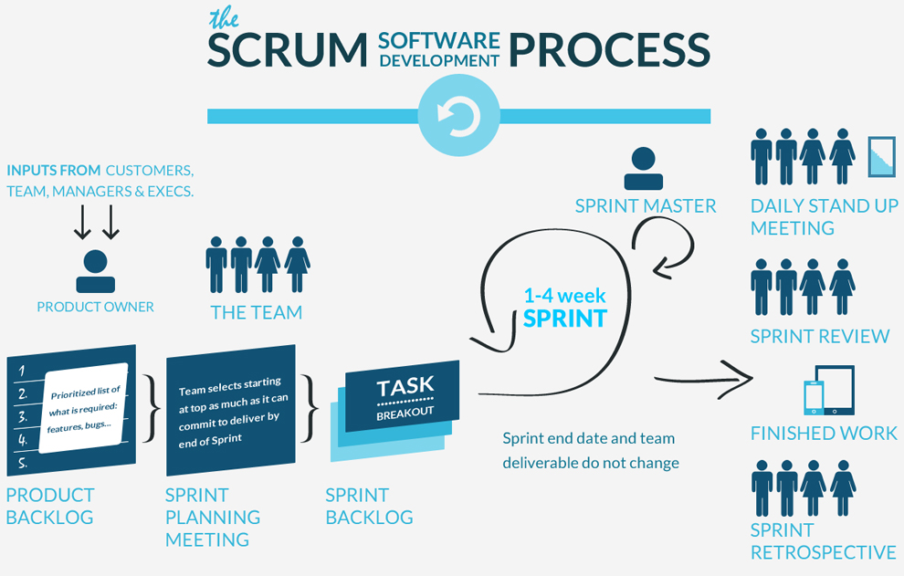
SCRUM
Phase de préparation
Phase de d’exécution

Slide 17
SCRUM
Phase de préparation
Phase de d’exécution

Slide 18
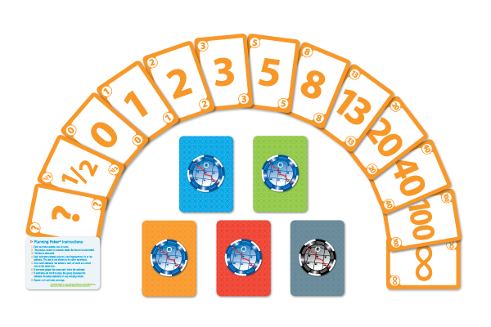
Poker Planning
SCRUM

Slide 19
SCRUM
Planning
Execution

Slide 20
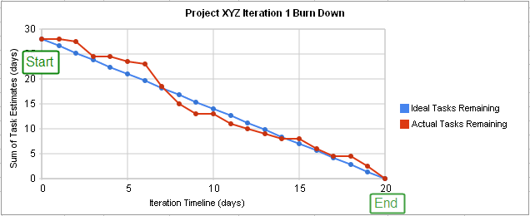
Scrum tracking burn down charts

Slide 21
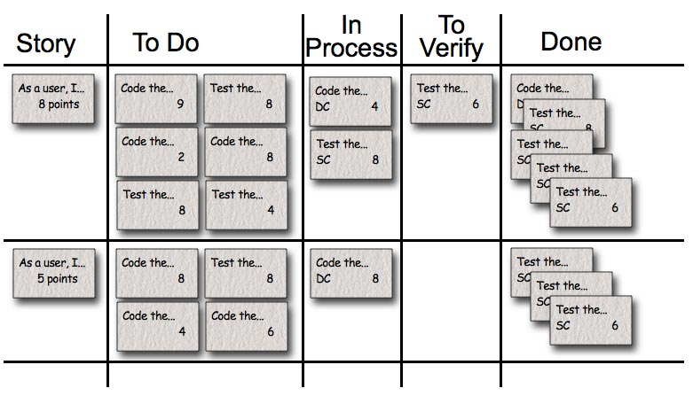
Sprint Iterations / Kanban Board
SCRUM

Slide 22
Managing Requirement
No detailed requirement specifications
Product backlog with these characteristics:
Transparent
Ordered based on value
Work to be done is estimated
Managed / Owned by product owner
Understood by the team

Slide 23
Transparency :
Every one can see it.
Stated in a manner that is understandable.
Requirements are expressed as :
User stories simple format easy to understand
Uses Cases formal syntax , more difficult
Gherkin “specifications by example “

Slide 24
Product backlog ordering to maximize value, increase ROI and to keep the team focused.
It can be ordered by :
By Value
By risk
By client needs

Slide 25
User stories
User : the consumer of the requirement
Story : what the user will consume
Acceptance Criterias : the bounderies and acceptance tests of the requirements. How to know if the requirement is satisfied.
Constraint : technical requirements
User stories are a way to foster conversations.

Slide 26
User stories Examples
As a user I want to reserve a hotel room.
As a user I want to cancel a reservation.
As a frequent flyer I want to see photos of hotels So I know what to expect.
As a user I want to so that ( business value )

Slide 27
Details are included as acceptance criterias or also they can be added as smaller sub user stories.
Valid product backlog Items
Features documentations
Constraints / non functional requirements
Bugs
User stories / uses cases

Slide 28
Value delivery
Value-driven delivery is an overarching principle for Agile projects. Projects are carried out to realize values (e.g. economic benefits, competitive advantages, reducing risks, regulatory compliance, etc.)
In terms of scrum, prioritization is the process where PO organize / select product backlog / user stories for implementation based on the perceived values.

Slide 29
Customer-valued Prioritization deliver the highest value to the customers as early as possible
the backlog should be customer-valued prioritized while taking into accounts technical feasibilities, risks, dependencies, etc. in order to win customer support

Slide 30
Value Prioritization Schemes
simple schemes – rank from high to low (priority 1, 2, 3, …)
MoSCoW prioritization scheme – Must have, Should have, Could have, Would like to have, in future
Monopoly money – ask customers to give out (fake) money to individual business features in order to compare the relative priority
100-Point method – customers are allowed to give, in total 100 points, to various features
Dot voting / Multi-voting – everyone is given a limited number of dots (~20% of the number of all options) to vote on the options
Kano analysis – plot the features on a graph with axes as Need Fulfilled / Not fulfilled vs Satisfied / Dissatisfied, each feature will then be classified as “exciters, satisfiers, dissatisfiers, indifferent”. Excitersare of highest values.
Requirements Prioritization model – rate each feature by benefits for having, penalty for not having, cost of producing, risks, etc. and calculate a score using a pre-defined weighted formula

Slide 31
CARVER (Criticality, Accessibility, Return, Vulnerability, Effect, and Recognizability) relative to the objective and mission of the project
Criticality – how important to be done upfront
Accessibility – can work on it immediately? or depends on other work / skills?
Return – ROI / NPV / IRR
Vulnerability – how easy to achieve the desired results?
Effect – what are the effects on the project (help moving towards the goal of the project)?
Recognizability – have the goals been clearly identified?
Relative Prioritization / Ranking
an ordered list of all user stories / features to be completed with 1 being the highest priority
when new features are to be added, it has to be compare, in terms of priority, to all current features
the schemes list above can be used to assist the relative prioritization / ranking tasks
Minimally Marketable Features (MMF)
the minimal functionality set (a group of user stories or a package of features) that can deliver values (e.g. useful) to the customers / end-users
a distinct and deliverable feature of the system that provides significant values to the customer (can be sold / used immediately)
chosen for implementation after value based prioritization
can reap return on investment instantly
Minimal Viable Product (MVP)
The minimal product (with just essential features and no more) that allows can be shipped to early adopters see and learn from the feedback instantly. The concept is somewhat similar to Minimally Marketable Feature (MMF) in which MVP is the first shippable product with the first set of MMF.

Slide 32
PSPO I exam
100 questions
1 hour
85% required to pass
200$USD
Open assessment : https://www.scrum.org/open-assessments/product-owner-open
Exam : https://www.scrum.org/professional-scrum-product-owner-i-certification

